Slide 1
Digital Forensics Lecture-2
By- Dr.subhranil Das
Assistant Professor
School of computer Science

Slide 2

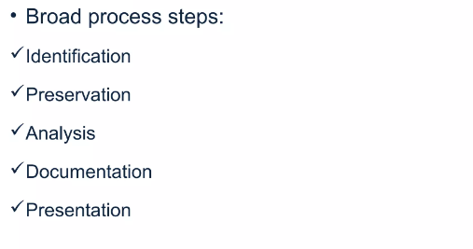
Digital Forensic Steps

Slide 3
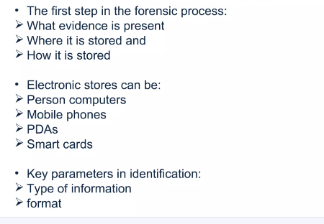
Identification

Slide 4
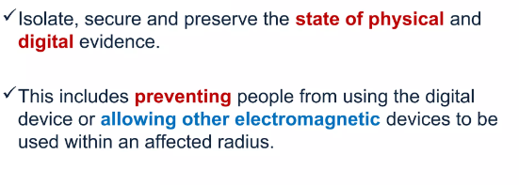
Preservation

Slide 5
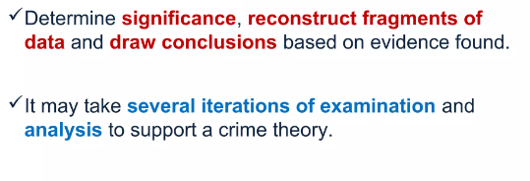
Analysis

Slide 6
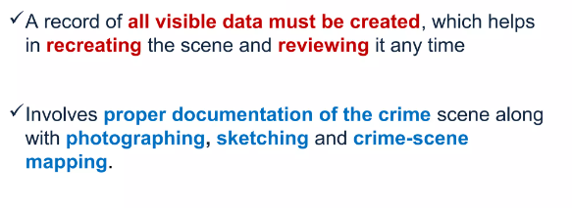
Documentation

Slide 7
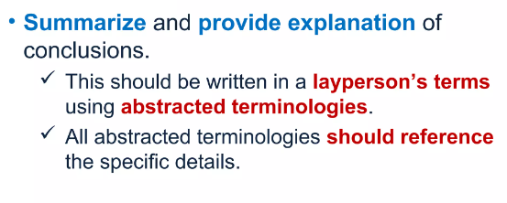
Presentation

Slide 8
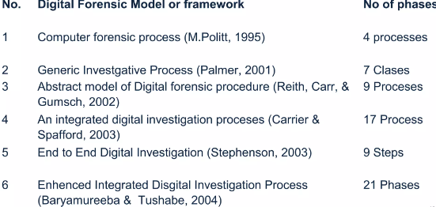
Different Models of Forensic Models

Slide 9
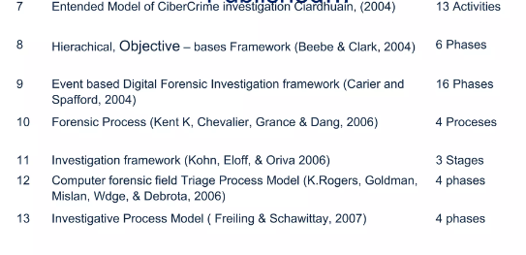
Different Models of Forensic Models

Slide 10
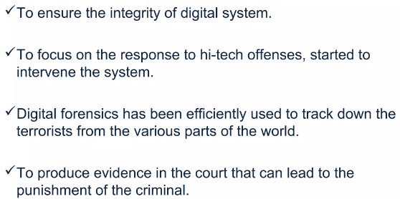
Need for Digital Forensics

Slide 11
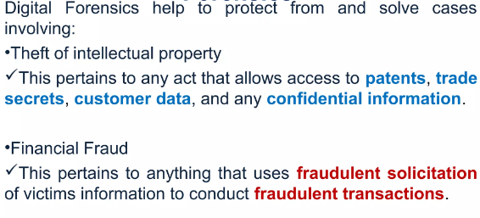
Application of Digital Forensics

Slide 12
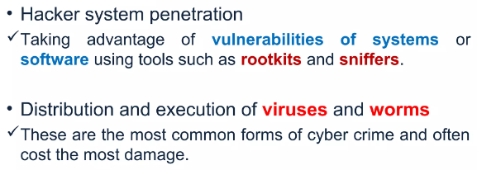
Application of Digital Forensics

Slide 13
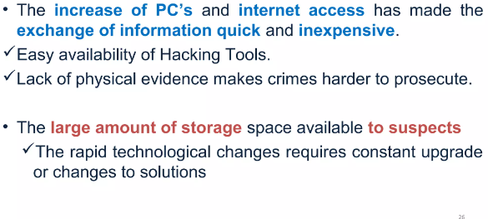
Challenges faced by Digital Forensics

Slide 14
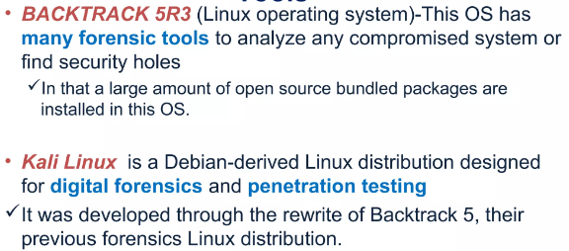
Tools for Digital Forensics

